Slide 1

Be Discerning
2 John
Dr. Rick Griffith • Crossroads International Church Singapore
BibleStudyDownloads.org

Slide 2

Lunar New Year Blessing 2020
Radio Bible Class

Slide 3
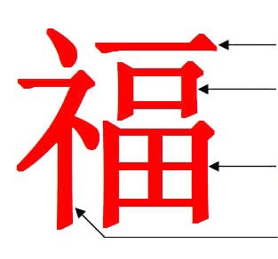
“Blessing”
One
Mouth (=Man)
Garden/Field
Divine Prefix
Notes:
Last week we were introduced to the amazing Chinese word for “blessing.”
It literally means one mouth (or man) in a garden in God’s presence!
Seriously! What an indication of Adam in the Garden of Eden with God’s blessing!

Slide 4

Genesis in Chinese Characters
See Dave Stewart, “The Story of Genesis in the Chinese Characters,” ShareShare presentation, https://www.slideshare.net/DaveSinNM/the-story-of-genesis-in-the-chinese-characters?qid=e6e52686-6545-4def-8537-2444d576b004&v=&b=&from_search=1, accessed 20 Jan 2020
Notes:
Many have noted that the story of Genesis is actually within the traditional Chinese characters.

Slide 5

“Create”
Create means to speak to dust to give life to a man so he can walk
to create
Speak = dust, life, man + walk/mud
Notes:
For example, the Chinese character for “create” has four components: dust, life, man and walk.

Slide 6


“Devil” & “Tempter”
Devil
Secret
Life
Man
Garden
Tempter
Devil
Cover
Forest/
Two Trees
Notes:
Chinese also has an insightful character for “devil” that shows a “secret” (or whisperer) for “life” told to a “man” in a “garden.”
That “devil” character forms the basis for the word “tempter,” which adds to devil words for “cover” among “two trees.”

Slide 7

“Boat”
The boat was a vessel of eight people
Boat
Vessel + Eight + People
Notes:
In Chinese, a large “boat” is formed with words for “vessel” and “eight people.” Doesn’t that sound like Noah, his wife, his three sons and their wives? There are actually over 270 Global Flood stories, but the Chinese one specifies the number of those saved as 8!

Slide 8
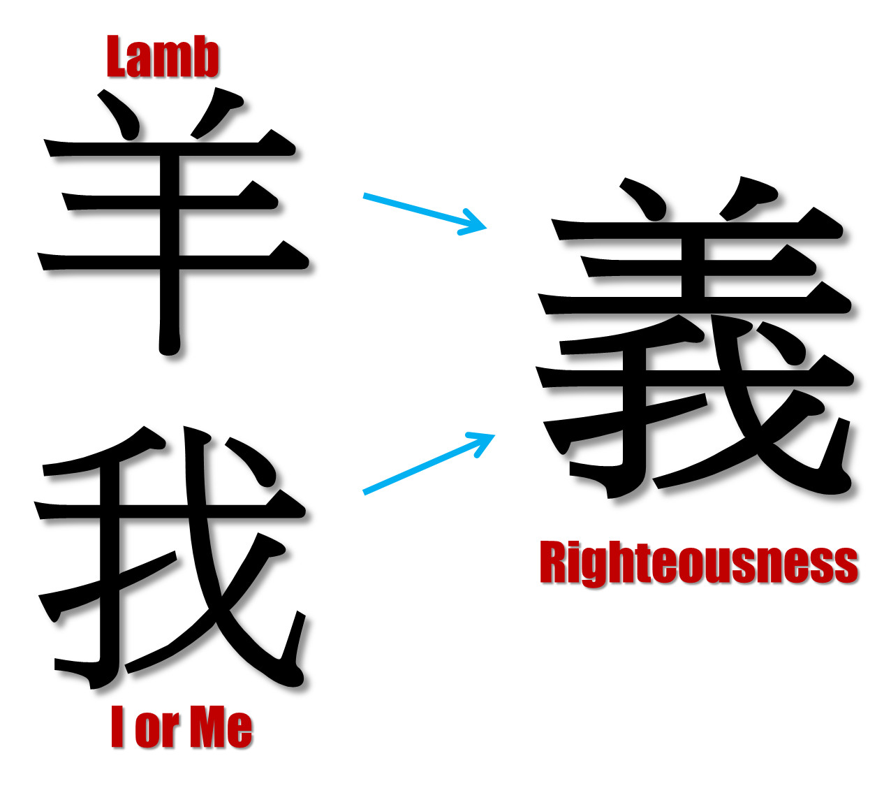
“Righteousness”
Lamb
I or Me
Notes:
As in most languages, the word for “me” is quite common. But Chinese puts the character for “lamb” over “me” to designate righteousness. We become righteous in God’s sight when overshadowed by the Lamb of God!

Slide 9
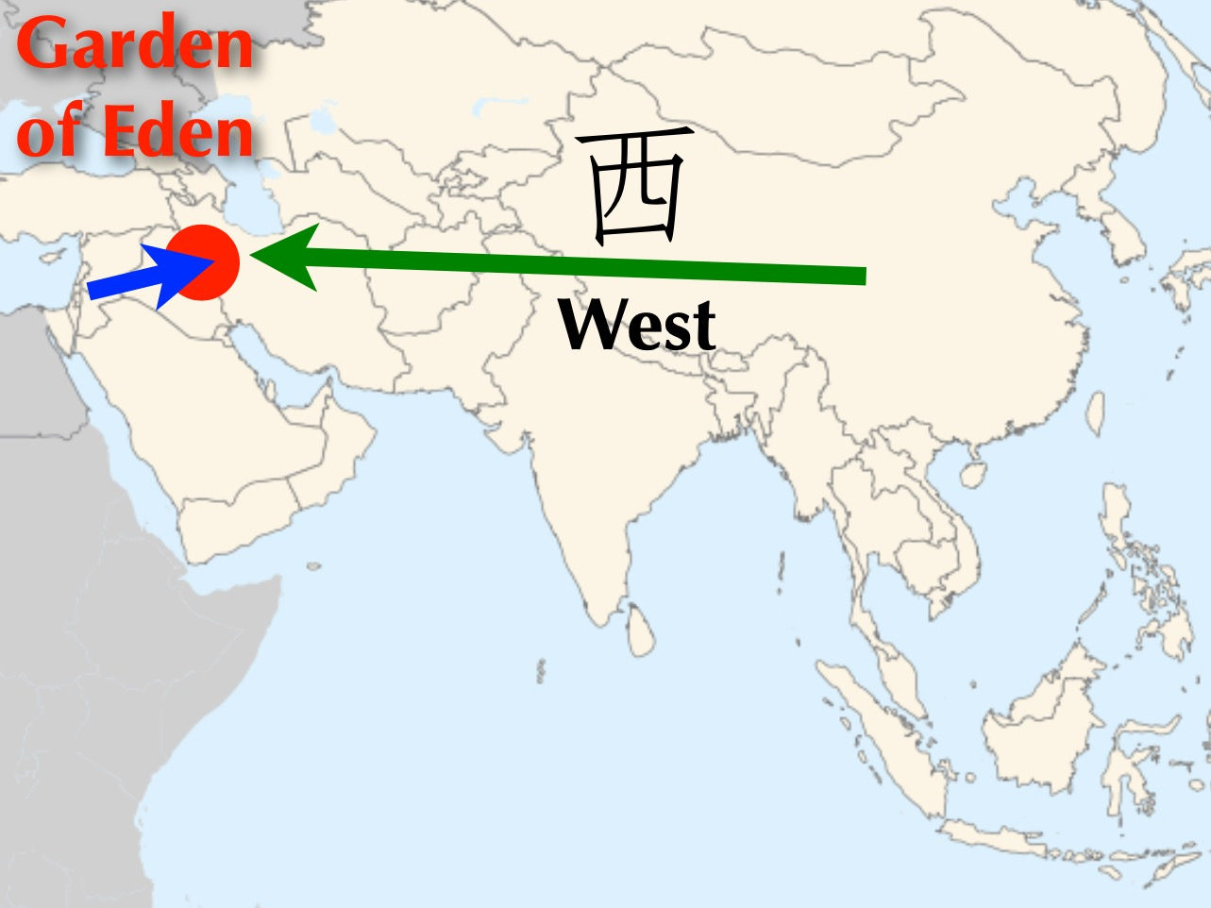
Garden of Eden
West
Notes:
Chinese has a very interesting word for “west.” Of course, the Garden of Eden was west of China.

Slide 10
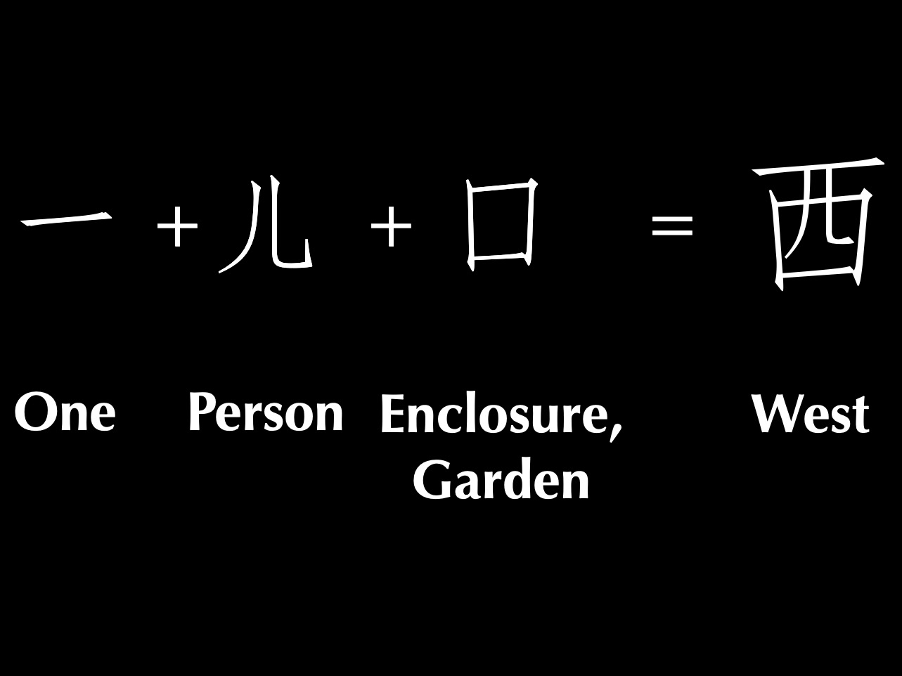
One man in a garden = West
One
Person
Enclosure,
Garden
West
Notes:
In Chinese, “west” literally means “one person in a garden” which took place west of China in the Middle East depiction of the Garden of Eden where God placed one man in a garden.

Slide 11

Title
One
Notes:
Many more Chinese examples are cited by authors such as C. H. Kang.

Slide 12

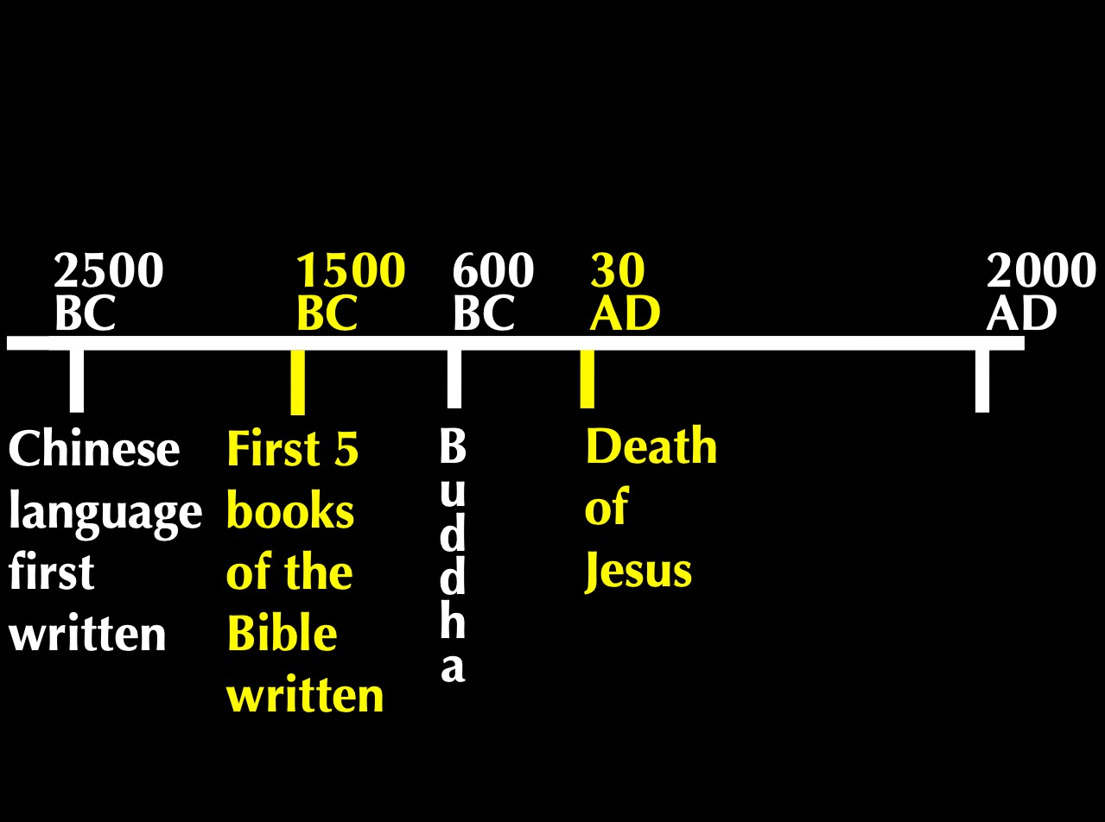
Timeline
2500
1500
400
33
2000
BC
AD
Chinese Language First Written
First 5 Books
of Bible Written
B
u
d
d
h
a
Death of Jesus
Notes:
So what’s the point? These Chinese words were basic to the language thousands of years before the Bible was translated into Chinese! We find them even 1000 years before Genesis was written, confirming their accuracy.
• In fact, the Chinese worshipped a single God, Shang Di, for thousands of years before Buddha lived.
But true teaching about God is always under attack.

Slide 13


“Lucky”?
“Blessing”?
Notes:
I showed this Chinese character for “blessing” to my non-Christian Chinese friend Jeffrey. He immediately looked at it and said, “Ah, lucky!” God’s blessings are reduced to luck in Satan’s relentless attack against the truth.

Slide 14
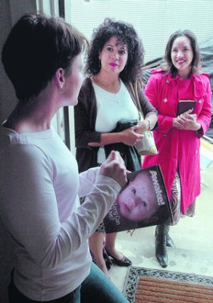
A Case Study…
Suppose two Jehovah's Witnesses come to your door. Will you invite them inside your home? Why or why not?
Please get into the right group…
2 John
Podium
Keep them out
Let them in
It depends
Notes:
It’s a lazy Saturday afternoon and you’re catching up on a few projects around the house. Then a knock comes at the door. You open it to discover two Jehovah's Witnesses. After talking a few minutes, they say to you, “It sounds like you have a keen interest in spiritual things. Can we hear more from you and tell us our understanding?”
• In such a situation, would you invite them inside your home? Why or why not?
• We often vote with our hands, but today I want you to vote with your feet, walking to a certain part of the room.
• Please get into the right group. • Those who would keep them out move left • those who would let them in move to the right side of the room • and those who need more information or feel it depends on certain factors move to the back. Ready, vote!
Why are you in that group? Tell those around you for the next minute.
Each group will now have 1-2 people tell the rest why they came to that group: first letting them in, second keeping them out and then the "it depends" group.
Please take your seats now.

Slide 15
Key Verse
297
“Anyone who runs ahead and does not continue in the teaching of Christ does not have God; whoever continues in the teaching has both the Father and the Son. If anyone comes to you and does not bring this teaching, do not take him into your home or welcome him” (2 John 9-10).
2 John
Notes:
Please be seated now. I’ve been in all 3 groups at various times—until vv. 9-10.

Slide 16
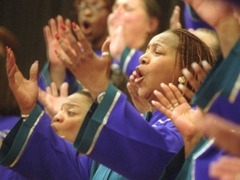
What's the Gospel?
Notes:
We are talking about the gospel—and how we respond to it.

Slide 17
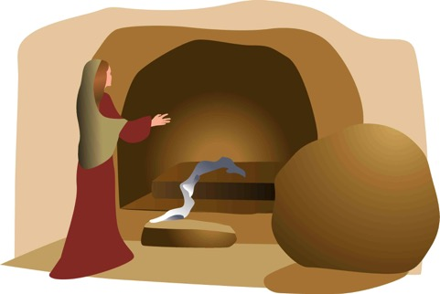
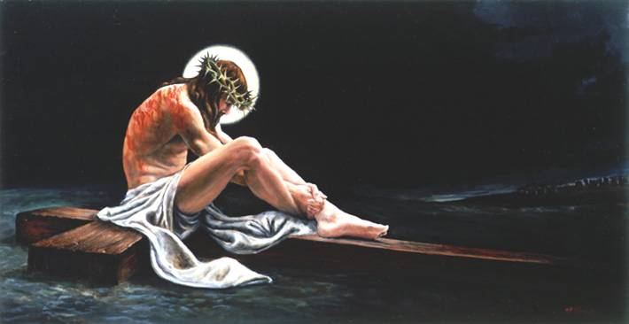
The Full Gospel
68
"Let me now remind you… of the Good News [Gospel]
I preached to you before…" (NLT)
Burial
Risen
Death
"Christ died for our sins…"
"He was raised from the dead on the third day…"
"He was buried…"
1 Cor. 15:3-4
Notes:
Most of us are here today because we believe Jesus died for our sins, was buried, and came alive again. Paul calls this the “good news” in 1 Corinthians 15:3-4.

Slide 18
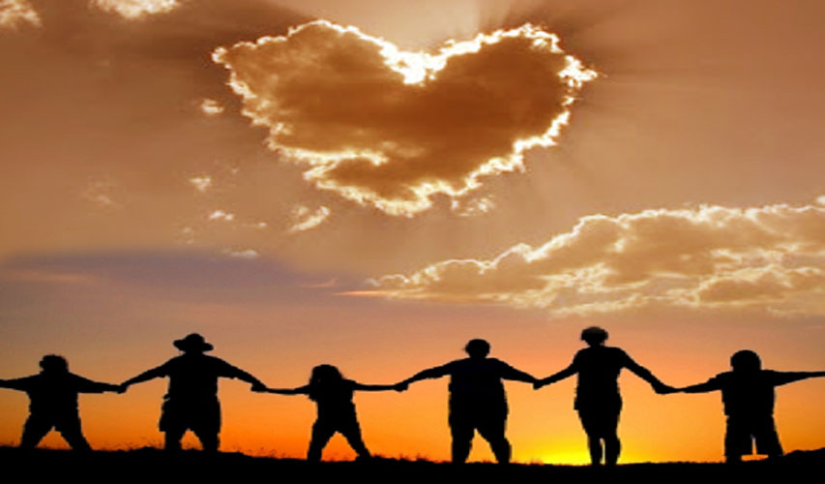
The Gospel
Is it really changing our lives?
2 John
Notes:
The gospel is supposed to change lives, showing us how to respond in a difficult situation such as dealing with false teaching.
In such a situation, how does the gospel tell us to respond?

Slide 19
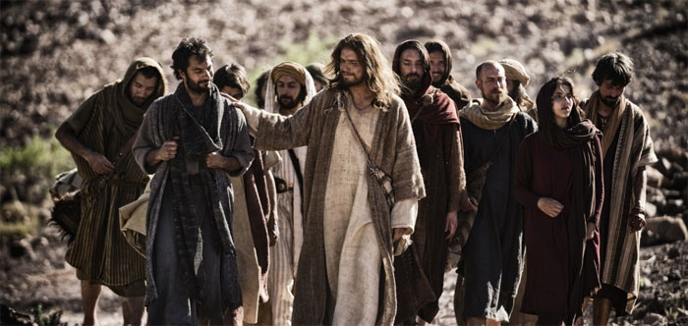
How can you live out the gospel?
Notes:
How do you act in a way that really honors God—especially when faced with heresy right in your face?

Slide 20
NT Overview (General + Key Words)
38
124
39-41
"To the remotest part of the earth" (Acts 1:8)
Acts 9 13 14 15 16 18 21 27 28
Apr 48-
Sep 49
1
Galatia
Apr 50-
Sep 52
2
Aegean
Spr 53-
May 57
3
Asia
Feb 60-
Mar 62
1
Rome
Spr 62-
Fall 67
4
Spain
Aut 67-
Spr 68
2
Rome
Summer 35-
37
Damascus
Antioch
May 57-
Aug 59
Trials
Fall 49
The
Council
Spring 68
Expansion of Church
35 48 49 50 52 53 57 60 62 67 68 95
Matt
Kingdom
Luke
Sov 1
Acts
Sov 2
Mark
Disciple
John
Believe
Gal
Justify
1 Thess
Rapture
1 Cor
Eph
Unity
1 Tim
Order
2 Tim
Sanctify
Doctrine
Jude
James
2 Thess
Tribulation
2 Cor
Col
Deity
Titus
Apostle
Conduct
Heb
1 John
Romans
Philem
1 Pet
2 John
Righteous
Forgive
Gospels & Acts
Phil
Attitude
2 Pet
Pauline Epistles
1234
Journeys
General Epistles
Rome
Imprisonments
General Epistles + Key Words
Notes:
Today we will focus on the little known letter of John called 2 John. It is one of the so-called General Epistle. With the exception of James, these letters appeared at the end of the first century.

Slide 21
Chapters in NT Books
Four "books" of the NT have but 1 chapter
Notes:
It doesn't seem right to call the four one-chapter writings "books" as they are so short!

Slide 22
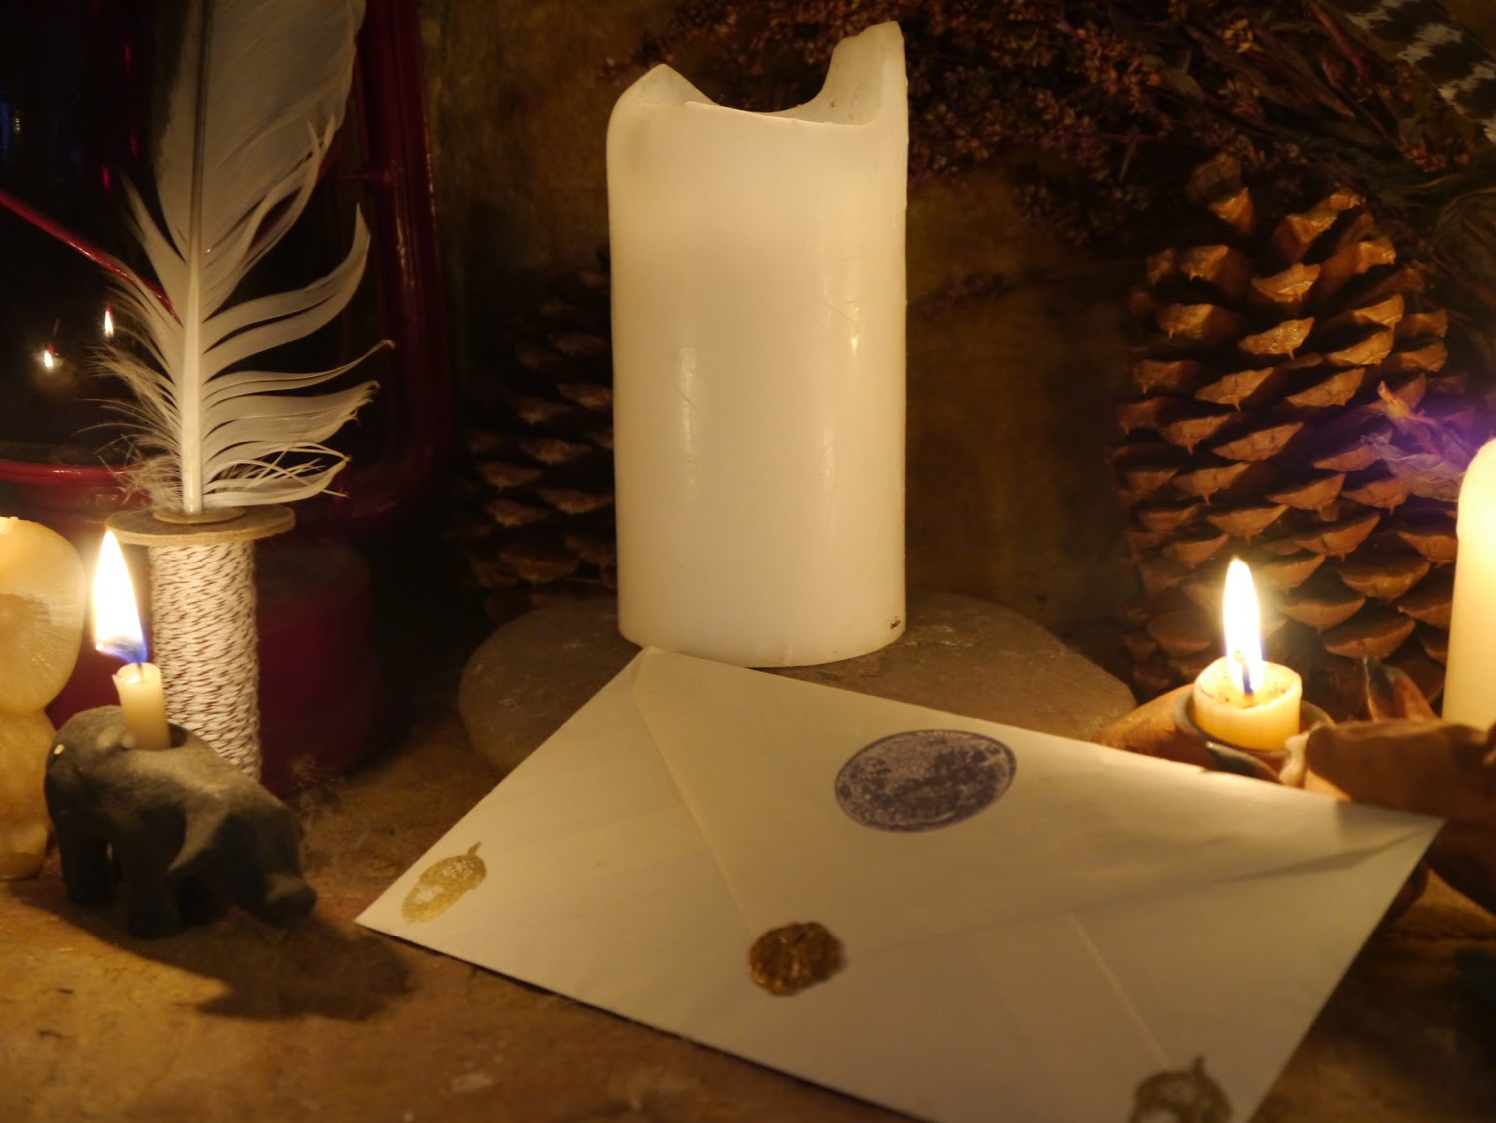
Verses in NT Emails
15
13
Words
245
219
Notes:
Each is about the length of an email, so I call them "NT Emails." The "E" is not for "electronic" but for "encouragement."

Slide 23
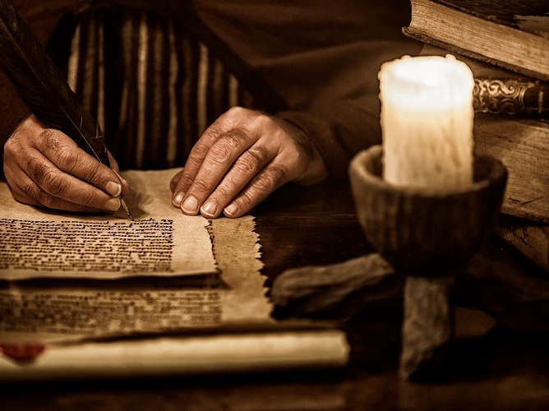
Date of Writing
298
Most scholars believe that John recorded this epistle about AD 90, although nothing in it excludes an earlier date.
Thus it was written in about AD 85-95.

Slide 24
Gnostics Taught a "Secret Knowledge"
291
-292
Two Types Addressed in 1-3 John
Docetic Gnosticism
From dokeo, "to seem"
(Christ only seemed to be a man)
Matter is Evil
Depreciated Materialism
Denied Christ's Humanity
Touched Jesus (1:1)
Led to Asceticism
Immorality exalted
Cerinthian Gnosticism
From Cerinthus, founder in Asia
(Christ only seemed to be God)
Spirit is Good
Exalted Knowledge (gnosis)
Denied Christ's Deity
Water & Blood (5:6)
Led to Pride
Education exalted
Notes:
Many Gnostics denied Jesus was a real man. Others exalted the spirit so much that they denied his deity.

Slide 25
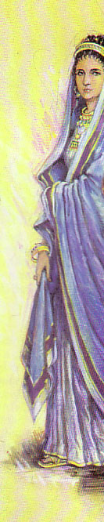
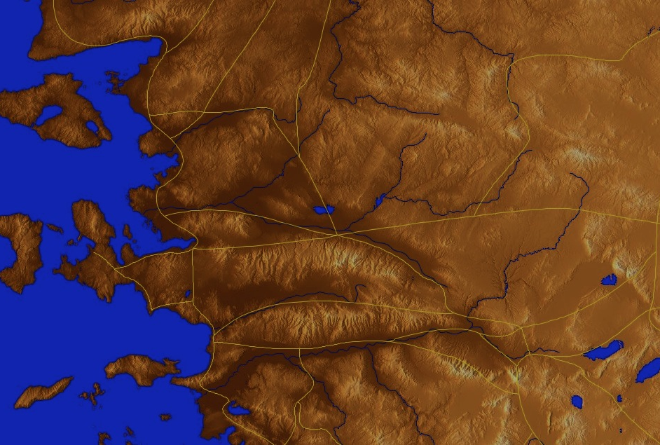
Origin/Recipient
298-299
Pergamum
"The Chosen Lady
& her children" (v. 1)
Thyatira
Sardis
Smyrna
Philadelphia
Ephesus
Laodicea
Colossae
Notes:
John wrote a woman to help her see how to live out the gospel in this difficult context.

Slide 26

Who is "the Chosen Lady & Her children"?
298-299
A figure for a local church?
The Virgin Mary?
An anonymous woman & her children who opened their home for church services & housed traveling preachers

Slide 27
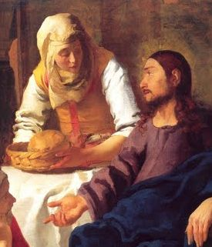
Occasion
299
Before the NT was completed and circulated among the early believers, churches relied on traveling preachers and teachers for truth.
Since inns were unsafe and few, these teachers stayed with Christians.

Slide 28
Occasion
299
Many hosts wondered, "Which teachers should I welcome to my home?"
John commands a hospitable woman to "put limits on her love" by refusing to house false teachers or to encourage them in any way.

Slide 29
How can you live out the gospel?
Two ways…
2 John
Notes:
What ways can you apply the Good News of Jesus?

Slide 30
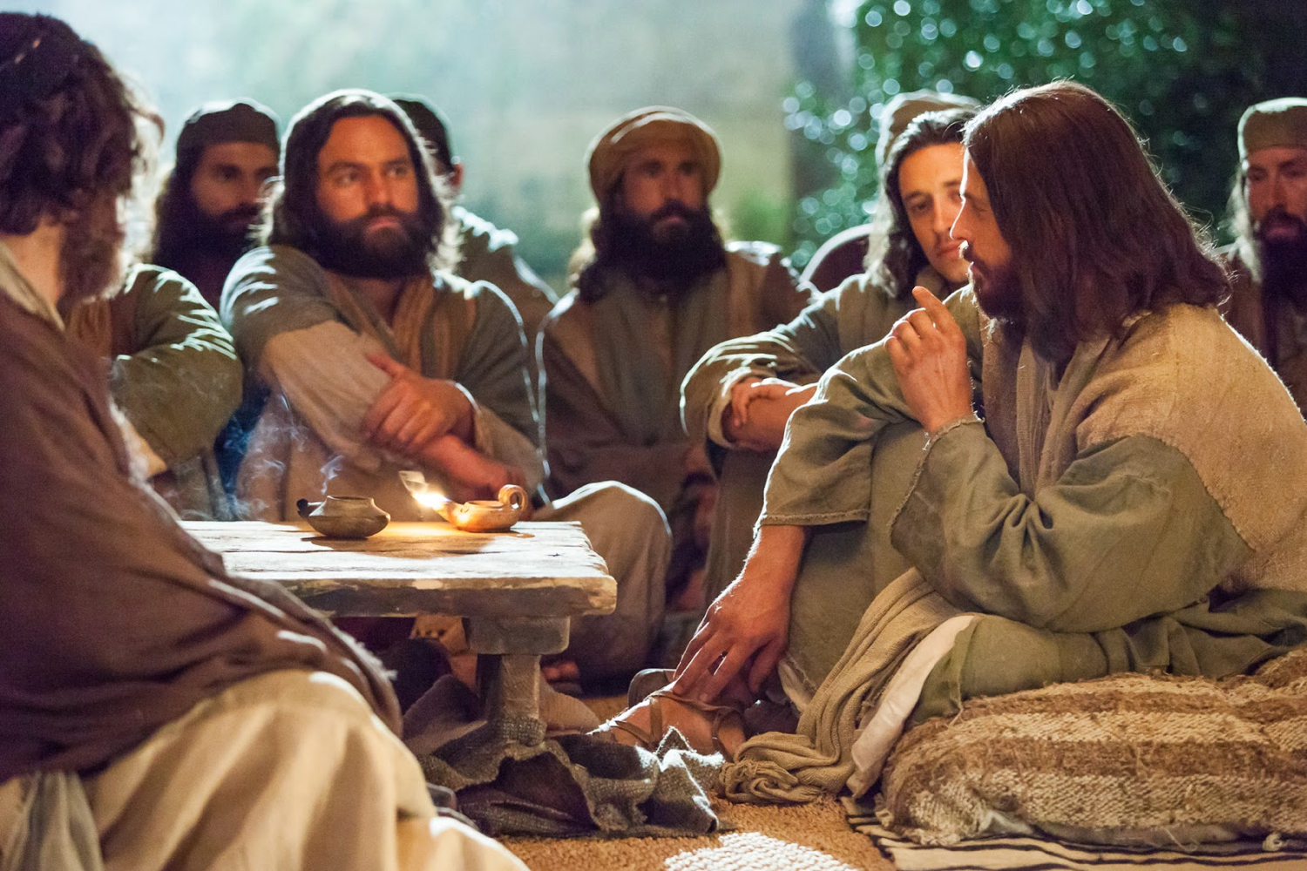
I. Aid true teachers (1-6).
2 John
Notes:
Support those preaching the right message about Christ (1-6).

Slide 31

Balancing Love and Truth
297
"All you need is love…" (The Beatles)
Do you agree? Why or why not?
Balance
Mushiness
Harshness
Love
Truth
Love
Truth
Notes:
The old Beatles song proclaimed, “All you need is love!” Is that true?
• Love is seen as more important than truth.
• Of course, others go to the other extreme by saying we only need truth as love is unimportant.
• Love without truth is mushiness.
• Truth without love is harshness.
• God’s will is for us to live in balance with BOTH love and truth. Notice how both are paired as I read the first 6 verses of this letter…

Slide 32
"This letter is from John, the elder. I am writing to the chosen lady and to her children, whom I love in the truth—as does everyone else who knows the truth—²because the truth lives in us and will be with us forever" (2 John 1-2 NLT).

Slide 33
"Grace, mercy, and peace, which come from God the Father and from Jesus Christ—the Son of the Father—will continue to be with us who live in truth and love. ⁴How happy I was to meet some of your children and find them living according to the truth, just as the Father commanded" (2 John 3-4 NLT).

Slide 34
"I am writing to remind you, dear friends [Greek: “lady”], that we should love one another. This is not a new commandment, but one we have had from the beginning. ⁶Love means doing what God has commanded us, and he has commanded us to love one another, just as you heard from the beginning"
(2 John 5-6 NLT).

Slide 35
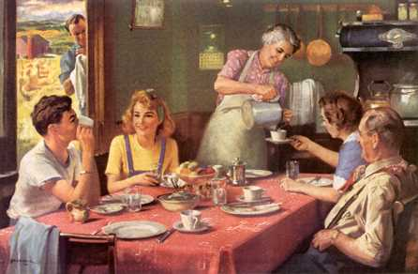
"Share with God's people who are in need. Practice hospitality." Romans 12:13 (NIV)
"Now the overseer must be . . . hospitable" 1 Timothy 3:2 (NIV)
"Offer hospitality to one another without grumbling." 1 Peter 4:9 (NIV)

Slide 36
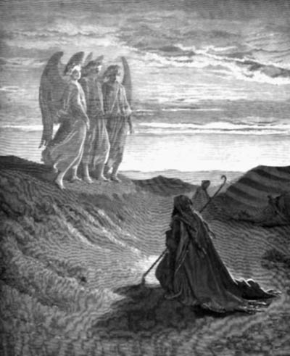
"Do not forget to entertain strangers, for by so doing some people have entertained angels without knowing it."
Hebrews 13:2 (NIV)

Slide 37
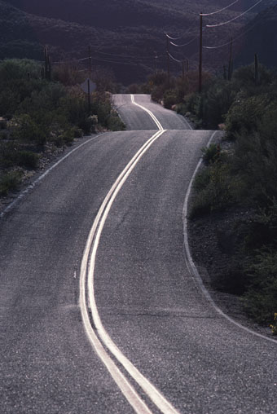
"I hope to visit you while passing through and to have you assist me on my journey there [Spain], after I have enjoyed your company for a while."
Romans 15:24 (NIV)

Slide 38
"Perhaps I will stay with you awhile, or even spend the winter, so that you can help me on my journey, wherever I go."
1 Corinthians 16:6

Slide 39
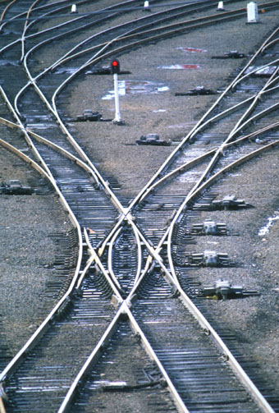
"Do everything you can to help Zenas the lawyer and Apollos on their way and see that they have everything they need."
Titus 3:13 (NIV)

Slide 40
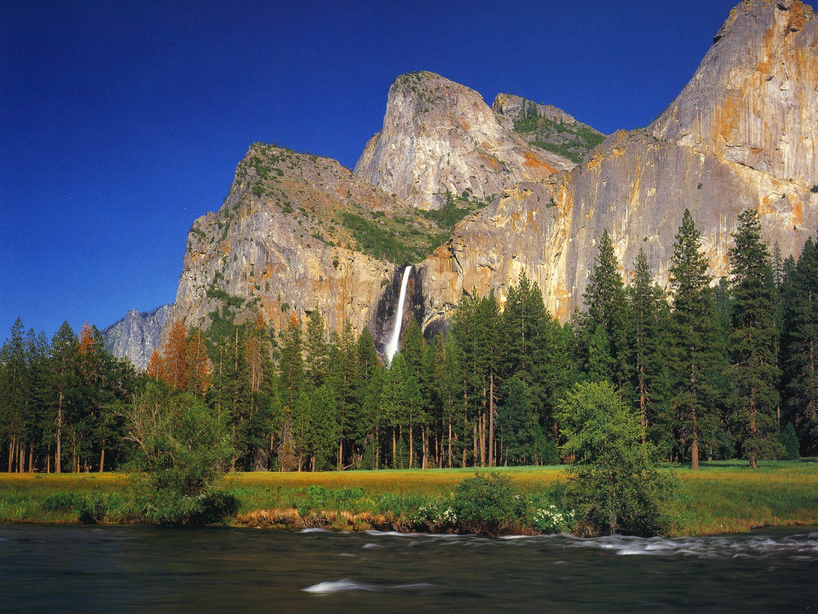
Didache 11:4 "Let every apostle, when he comes to you, be received as the Lord;"

Slide 41
Didache 11:5 "but he shall not abide more than a single day, or if there be need, a second likewise; but if he abides three days, he is a false prophet."

Slide 42
Didache 11:6 "And when he departs let the apostle receive nothing except bread, until he finds shelter; but if he asks for money, he is a false prophet."

Slide 43
Didache 12:1 "But let every one that comes in the name of the Lord be received; and then when you have tested him you shall know him."

Slide 44
Didache 12:2 "If the comer is a traveler, assist him, so far as you are able; but he shall not stay with you more than two or three days, if it be necessary."

Slide 45
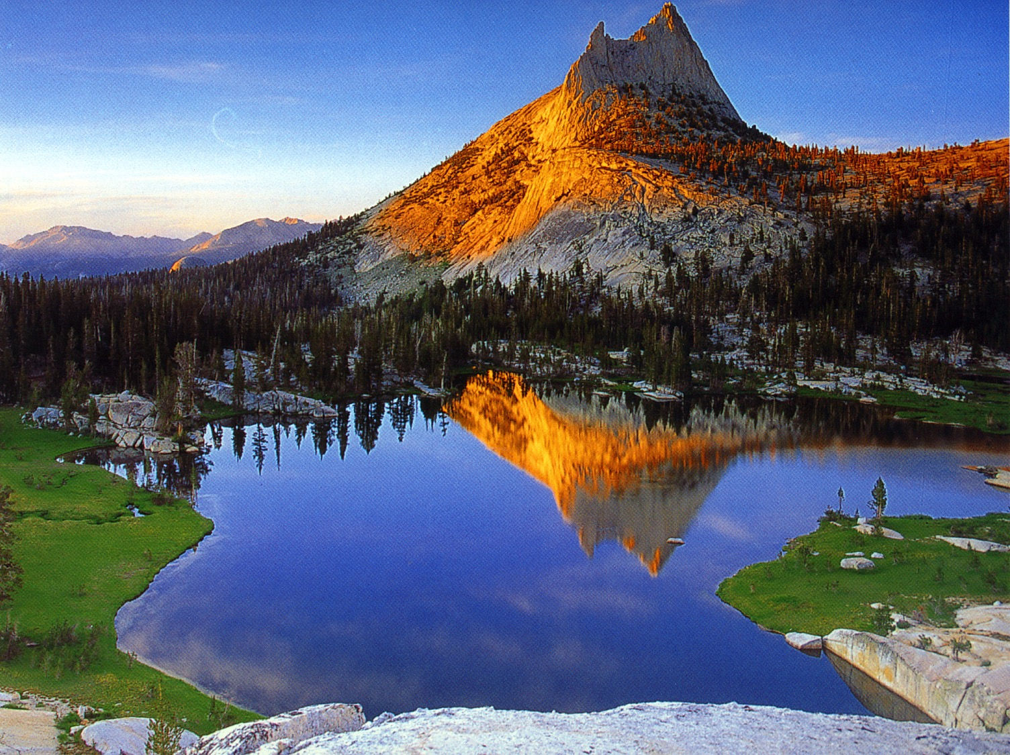
"Freely you have received, freely give."
Matthew 10:7 (NIV)

Slide 46
"This is how we know what love is: Jesus Christ laid down his life for us. And we ought to lay down our lives for our brothers."
1 John 3:16 (NIV)

Slide 47
How can you live out the gospel?
Two ways…
2 John
Notes:
What ways can you apply the Good News of Jesus?

Slide 48
I. Aid true teachers (1-6).
2 John
Notes:
Support those preaching the right message about Christ (1-6).

Slide 49
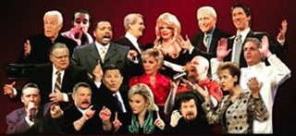
II. Avoid false teachers (7-13).
2 John
Notes:
Do not support preachers of heresy (7-13).

Slide 50

"I say this because many deceivers have gone out into the world. They deny that Jesus Christ came in a real body. Such a person is a deceiver and an antichrist"
(2 John 7 NLT).
Notes:
We must not support heretics (7-11).
False teachers who deny that Christ is incarnate God are numerous, deceptive and totally against Christ, so the woman should consider how she may be supporting such men (7).

Slide 51
"Watch out that you do not lose what we have worked so hard to achieve. Be diligent so that you receive your full reward. ⁹Anyone who wanders away from this teaching has no relationship with God. But anyone who remains in the teaching of Christ has a relationship with both the Father and the Son"
(2 John 8-9 NLT).
Notes:
Believers can lose the rewards that they have earned for the Judgment Seat of Christ to cause the woman to consider whether her aid to false teachers really receives God's blessing (8).
Rewards can be lost when believers go beyond orthodox teaching by adhering to heresy without God's approval, so she should please God by remaining steadfast in doctrine (9).

Slide 52
"If anyone comes to your meeting and does not teach the truth about Christ, don't invite that person into your home or give any kind of encouragement. ¹¹Anyone who encourages such people becomes a partner in their evil work"
(2 John 10-11 NLT).
Notes:
A Christian must never invite false teachers inside one’s home or even greet those who propagate destructive heresies, so this woman's love must be discerning and have limits (10).
Anyone who even greets a proselytizing false teacher encourages him in his heresies and helps promote his evil work, so the woman must see she is aiding Satan's workers (11).

Slide 53
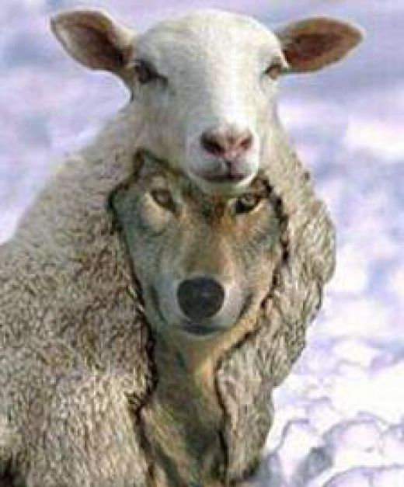
The Meaning of 2 John 10
Summary of Differing Views
304
Can False Teachers. . .
View Stay in Believers Homes? Enter Believers' Homes? Adherents
1 Yes Yes John R. Stott
F. F. Bruce
2 No Yes Stanley Toussaint
3 No ? I. Howard Marshall
B. F. Westcott
Robert Weldon Wilson
4 No No Rick Griffith

Slide 54
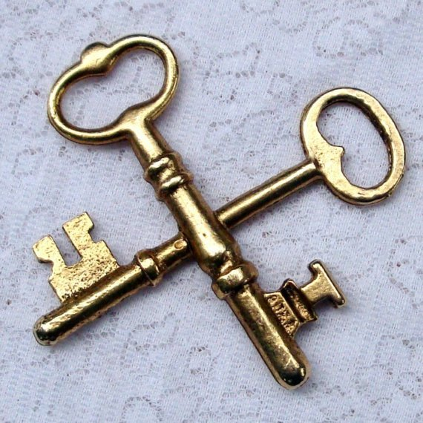
Keys
297
Key Word
Limits
Key Verse
"Anyone who runs ahead and does not continue in the teaching of Christ does not have God; whoever continues in the teaching has both the Father and the Son. If anyone comes to you and does not bring this teaching, do not take him into your home or welcome him" (2 John 9-10 NIV).

Slide 55
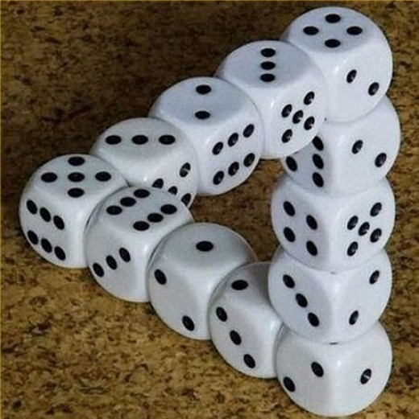
Too good to be true the-ology

Slide 56
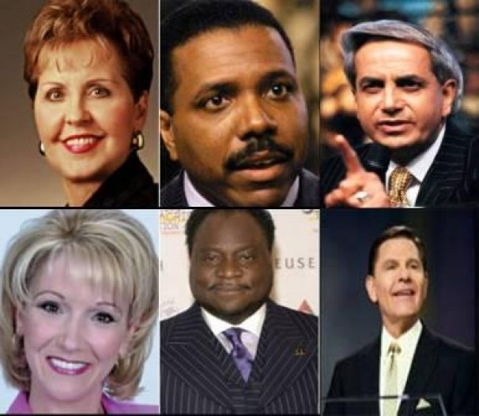
Joyce Meyers in her
$2 million jet, etc.

Slide 57
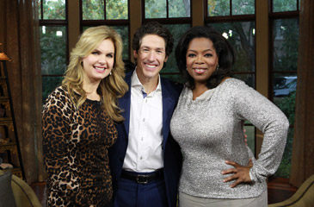
Oprah Winfrey

Slide 58
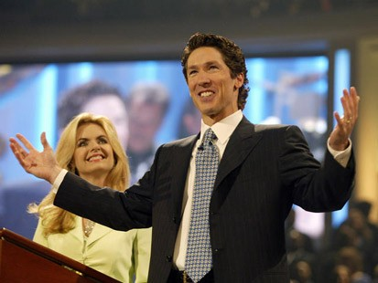
Joel Osteen
No preaching on sin
Led in prayer at gay "wedding"

Slide 59

Motivational Speaking
Magical prayers, feel good messages, have it your way theology; surely this is too awesome to be what Paul warned us about
http://www.conservativecut.com/blog/?tag=false-teacher
Notes:
http://www.conservativecut.com/blog/?tag=false-teacher

Slide 60
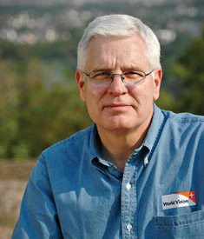
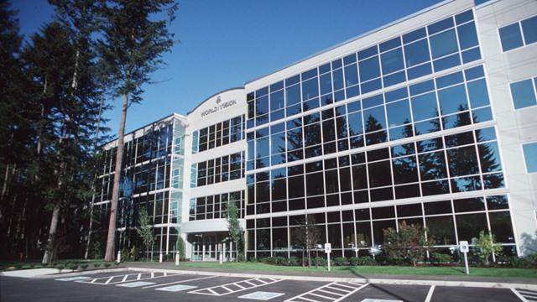
World Vision Controversy
CEO Richard Stearns
Notes:
World Vision Reverses Decision To Hire Christians in Same-Sex Marriages
(UPDATED) President Richard Stearns: 'Certain beliefs are so core to our Trinitarian faith that we must take a strong stand on those beliefs.'
Celeste Gracey and Jeremy Weber/ March 26, 2014
Only two days after announcing it would hire Christians in same-sex marriages, World Vision U.S. has reversed its ground-breaking decision after weathering intense criticism from evangelical leaders.
"The last couple of days have been painful," president Richard Stearns told reporters this evening. "We feel pain and a broken heart for the confusion we caused for many friends who saw this policy change as a strong reversal of World Vision's commitment to biblical authority, which it was not intended to be."
"Rather than creating more unity [among Christians], we created more division, and that was not the intent," said Stearns. "Our board acknowledged that the policy change we made was a mistake … and we believe that [World Vision supporters] helped us to see that with more clarity … and we're asking you to forgive us for that mistake."
http://www.christianitytoday.com/ct/2014/march-web-only/world-vision-reverses-decision-gay-same-sex-marriage.html accessed 8 April 2014

Slide 61
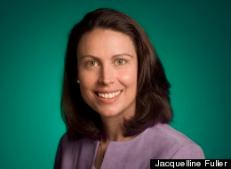
World Vision Controversy
Jacqueline Fuller
Notes:
World Vision board member quits over gay marriage hiring ban
Google's Jacqueline Fuller leaves Christian charity's board after it reverses decision to hire workers in same-sex marriages
Share 113
inShare0
Email
Associated Press in Seattle
theguardian.com, Thursday 3 April 2014 01.31 BST
Jump to comments (12)
A World Vision board member has resigned in protest after the Christian aid group quickly reversed its decision to hire employees in same-sex marriages.
Jacqueline Fuller, director of corporate giving for Google, said in an email to the Associated Press on Wednesday she remained a "huge fan" of the group's work on behalf of the poor, but she had resigned on Friday "as I disagreed with the decision to exclude gay employees who marry".
She declined to comment further.
http://www.theguardian.com/society/2014/apr/03/world-vision-board-member-quits-gay-marriage-hiring

Slide 62
2 John – Summary Chart
297
Limits to Love
Aid True Teachers
Avoid False Teachers
Verses 1-6
Verses 7-13
Walk in Commandments
Watch for Counterfeits
Positive
Negative
Demonstrate Truth
Defend Truth
Greeting in Truth and Love
(1-3)
Obedience Commended (4)
Exhortation to Love
(5-6)
Prohibition to Help False Teachers
(7-11)
Expected Visit & Greetings
(12-13)
Ephesus
AD 85-95

Slide 63
Follow Up Relationally (12-13)
"I have much more to say to you, but I don't want to do it with paper and ink. For I hope to visit you soon and talk with you face to face. Then our joy will be complete. ¹³Greetings from the children of your sister, chosen by God"
(2 John 12-13 NLT).
Notes:
John wants to clarify his teaching about discerning love by a personal visit that is better than a letter and would be a joyful rather than stern time (12).
More teaching on the delicate subject of responding to false teachers is needed, but not through a letter (12a).
A personal, face-to-face visit would better clarify John’s teaching and result in a joyful time rather than a list of stern regulations (12b).
John sends greetings from her nephews and nieces to end in an affectionate way (13).

Slide 64
How can you live out the gospel?
2 John
Notes:
What ways can you apply the Good News of Jesus?

Slide 65
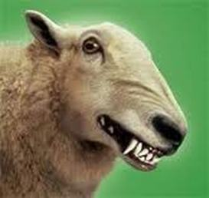
Main Idea
Live the gospel
by not aiding those who hinder the gospel
2 John
Notes:
In 2 John 10 we see the teaching in a nutshell: Do not encourage false teaching in any way so you can live out the Good News!

Slide 66
Outline
300-301
I. John encourages a woman in both truth and love to prepare her for his later rebuke (1-6).
II. John warns the woman not to help false teachers to help her see love's limits (7-13).

Slide 67
I. Aid true teachers (1-6).
2 John
Notes:
Support those preaching the right message about Christ (1-6).

Slide 68
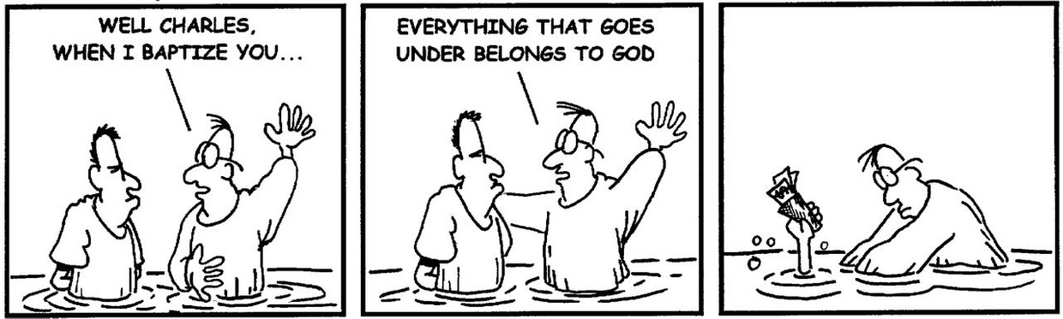
Well, Charles, when I baptize you…

Slide 69
Everything that goes under belongs to God.

Slide 70
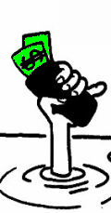

Slide 71

"He who receives you receives me, and he who receives me receives the one who sent me" Matthew 10:40 (NIV)
"And if anyone gives even a cup of cold water to one of these little ones because he is my disciple,
I tell you the truth, he will certainly not lose his reward"
Matthew 10:42 (NIV)

Slide 72
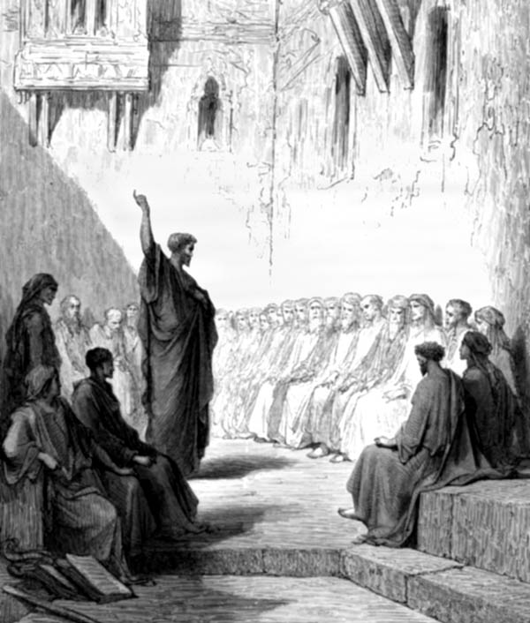
"In the same way, the Lord has commanded that those who preach the gospel should receive their living from the gospel."
1 Corinthians 9:14 (NIV)

Slide 73
"Anyone who receives instruction in the word must share all good things with his instructor."
Galatians 6:6 (NIV)

Slide 74
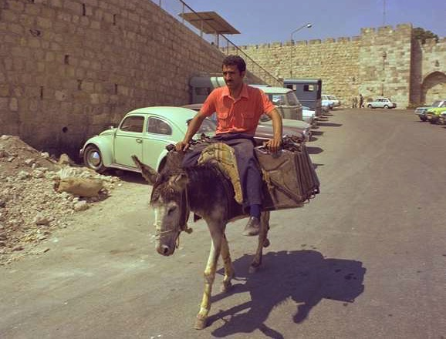
"Surely you remember, brothers, our toil and hardship; we worked night and day in order not to be a burden to anyone while we preached the gospel of God to you."
1 Thessalonians 2:9 (NIV)

Slide 75
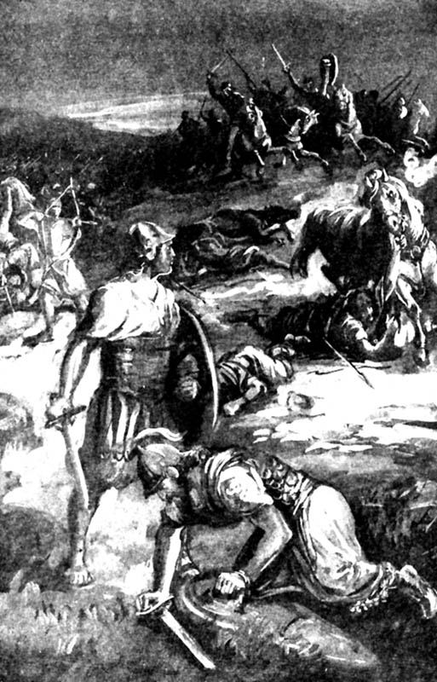
"The share of the man who stayed with the supplies is to be the same as that of him who went down to the battle. All will share alike."
1 Samuel 30:24 (NIV)

Slide 76
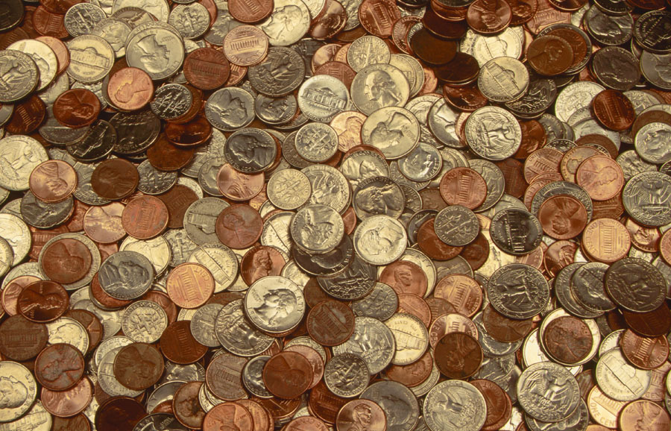
"Not that I am looking for a gift, but I am looking for what may be credited to your account."
Philippians 4:17 (NIV)

Slide 77

"God is not unjust; he will not forget your work and the love you have shown him as you have helped his people and continue to help them."
Hebrews 6:10 (NIV)

Slide 78
II. Avoid false teachers (7-13).
2 John
Notes:
Do not support preachers of heresy (7-13).

Slide 79

Key Word / Verse
297
Key Word
Limits
Key Verse
"Anyone who runs ahead and does not continue in the teaching of Christ does not have God; whoever continues in the teaching has both the Father and the Son. If anyone comes to you and does not bring this teaching, do not take him into your home or welcome him" (2 John 9-10 NIV).

Slide 80

Summary Statement
300
John exhorts limits to love for a Christian woman and her children who show hospitality to missionaries but need warning not to extend the same to false teachers to warn against aiding the spread of destructive heresies.

Slide 81

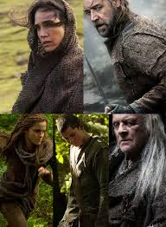
Noah
Shadowed

Slide 82
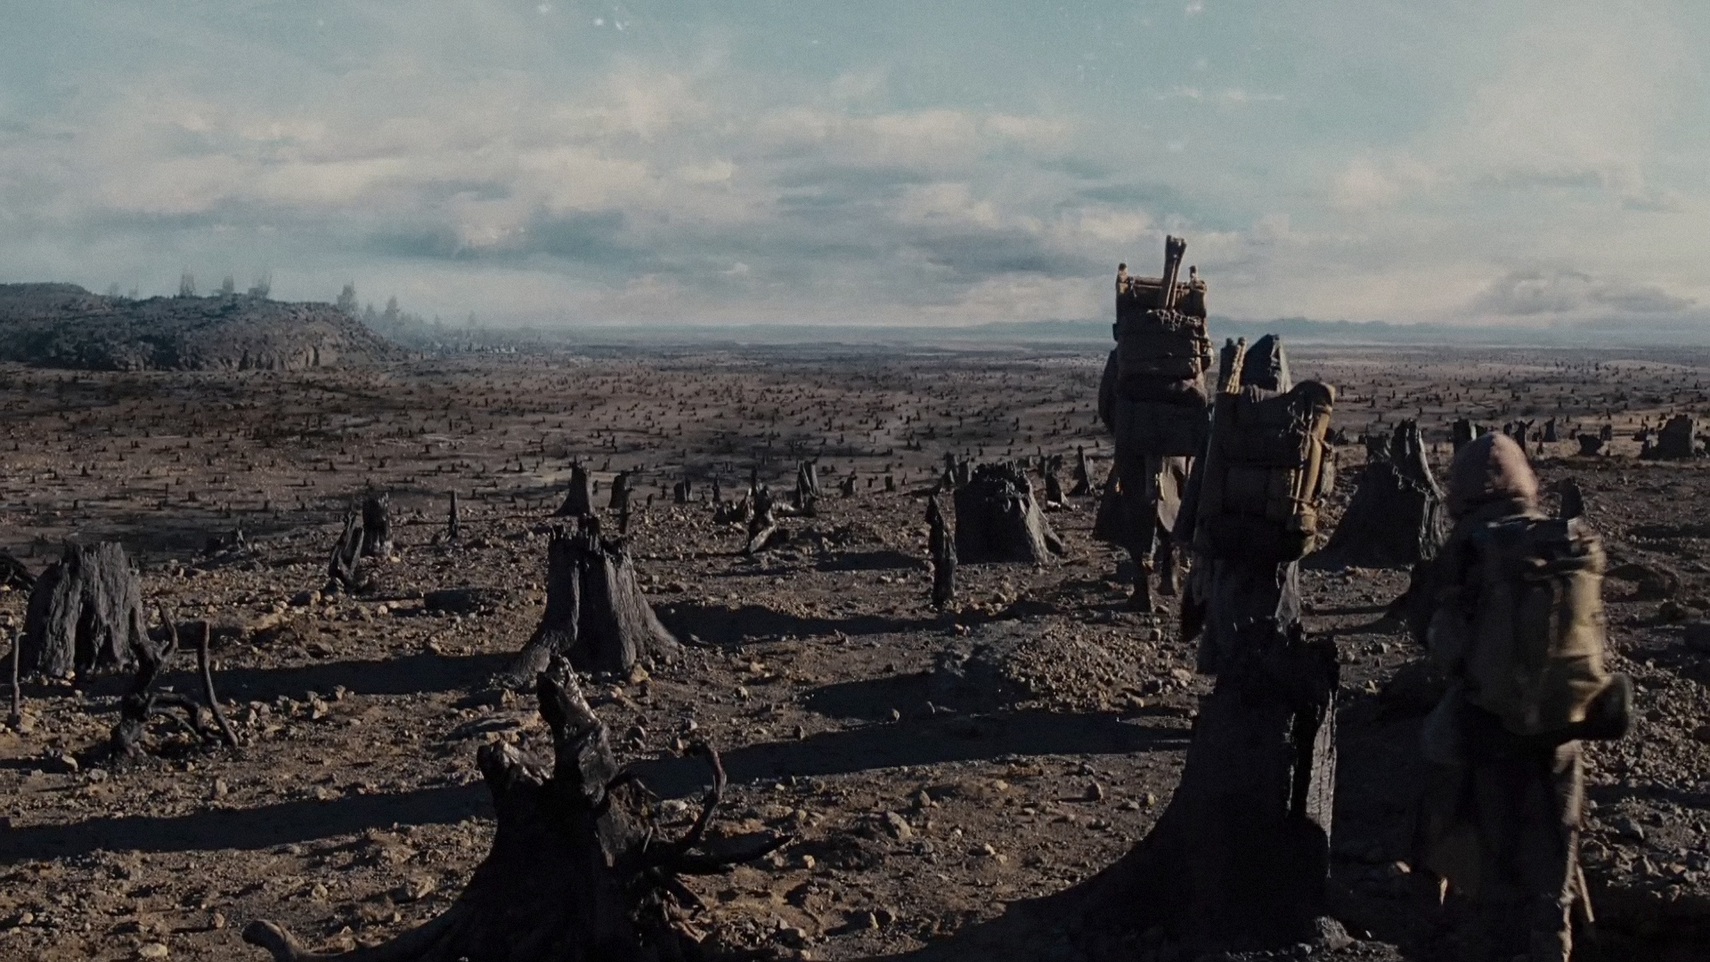
Noah
Thesis: The earth must be destroyed due to man not taking care of the environment!

Slide 83
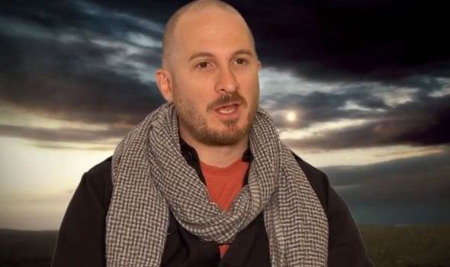
Atheist Producer Darren Aronofsky
"least biblical biblical film ever made."
Notes:
"Russell Crowe hits 'Noah' critics: 'Bordering on absolute stupidity'". The Washington Times. March 27, 2014. Retrieved March 27, 2014; cited at Wikipedia, "Noah (movie)."

Slide 84

Noah
Should Christians see it?

Slide 85
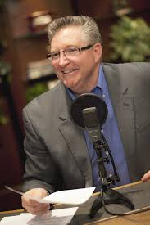
Praise of "Noah"
Focus on the Family president Jim Daly stated that: "[Noah] is a creative interpretation of the scriptural account that allows us to imagine the deep struggles Noah may have wrestled with as he answered God's call on his life. This cinematic vision of Noah's story gives Christians a great opportunity to engage our culture with the biblical Noah, and to have conversations with friends and family about matters of eternal significance."
https://en.wikipedia.org/wiki/Noah_%282014_film%29#Test_screenings
Notes:
http://www.refiningtruth.com/noah-genesis-6-facts/

Slide 86
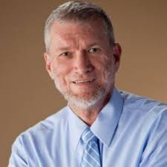
Criticism of "Noah"
Ken Ham (Answers in Genesis):
"Also, while the extreme wickedness of man was depicted, the real sin displayed in the film was the people's destruction of the earth. Lost within the film's extreme environmentalist message is that the actual sins of the preflood people were rebellion against God and man's inhumanity to man."
http://time.com/42274/ken-ham-the-unbiblical-noah-is-a-fable-of-a-film/

Slide 87

How do Christians aid heresy?
297
Encouraging itinerate heretics
Giving money to cults (YouTube preachers, etc.)
Buying heretical books
Attending movies that violate Scripture
Accepting literature from false evangelists

Slide 88
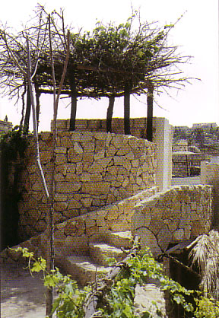
What Does All This Mean?
297
You are a watchtower!
Don't contribute to or encourage in any way Buddhism, Islam, Hinduism, Mormonism, Jehovah's Witnesses or any other false religion.

Slide 90


NT Preaching link at BibleStudyDownloads.org
Get this presentation and script for free!
Notes:
OT Preaching (op)

